Slide 1
PASS1A/PASS1C UM Metabolomics Datasets

Slide 2
Our Last Discussion

Slide 3
Data Organization Tasks
Collect missing Manifest files
Repair Manifest files for PASS1A
Only for those missing; task mostly complete
Repair Manifest files for PASS1C
Standardize Manifest files
Complete data matrices (can be done without manifest files if needed)

Slide 4
Data Processing Talk—Biology Left Out for Brevity Many Plots Today

Slide 5
PASS1A Metabolomics Datasets (n = 205)
Tissues
(n = 20)
Targeted (Y/N)
Sites
(n = 6)
Technology
Platform
Named (Y/N)
# of Samples
# Metabolites
Metabolomics release 2.0, received October 15th, 2020 from MoTrPAC DataHub (motrpac-data.org)
Notes:
This is PASS1A metabolomics release 2.0 and it has 205 datasets, It’s different than RNASEq, it’s much more complex.
There’s 6 sites here, if we had RNASEq from 6 sites, then we wouldn’t have 205 datasets.
-The Datasets are split up by all sorts of variables, different platforms, different sites, different technologies, named or unnamed
-You can think of this as a 6 Dimension annotation
-At the bottom here, you can actually see a distribution if # of metabolites and # of samples, so you can really get a sense as to where these samples and metabolites consentrate.
-Today, we are going to look at comparions between these datsets.
-We’re gonna focus on comparisons with the largest overlap between samples and features as an example to highlight some of the major conclusions we see in other comparisons.
-Today we’re concerned with named dataset, so one of the first things we’re gonna to is removed the unnamed dataset.

Slide 6
PASS1A/PASS1C UM Matched Metabolomics Datasets & Dimensions (n = 46) *Dimensions include reference samples
Notes:
Determine which reference samples are shared between PASS1A and PASS1C
-Consider run order
-Vertically across tissues
-Send Jun analysis plan

Slide 7
IONPNEG: 4 Tissues Not Matched in PASS1C

Slide 8
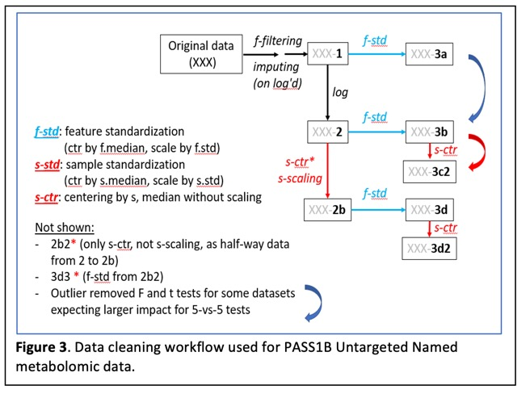
Data Infrastructure & Resources
Annotation
Sample Run Order File
Updated Phenotypes
Pass1a
Pass1c
Data
Matrixes for each dataset
Similar organization as PASS1B
Figure generated by Jun Li, PhD

Slide 9
Umich rppos (pass1a & pass1c)

Slide 10
Umich rppos processed (pass1a & pass1c)

Slide 11
Example of Data Processing: Plasma rppos PASS1c

Slide 12
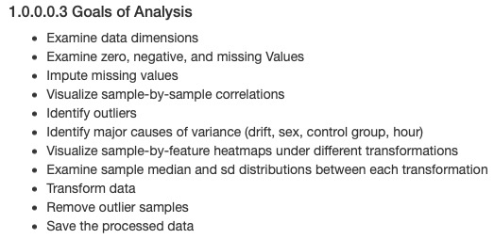
Example of Data Processing: Plasma rppos PASS1c

Slide 13
Example of Data Processing: Plasma rppos PASS1c

Slide 14
Real-Time Record of Processing Decisions

Slide 15
Real-Time Record of Processing Decisions
pla rppos pass1c

Slide 16
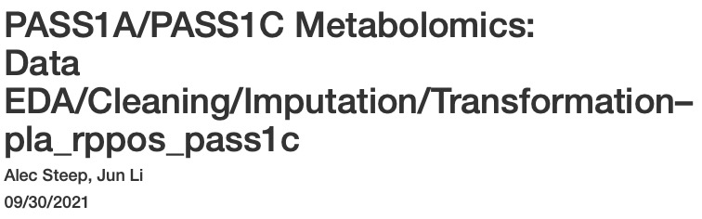
Processing is Documented for Each Dataset

Slide 17
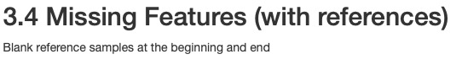
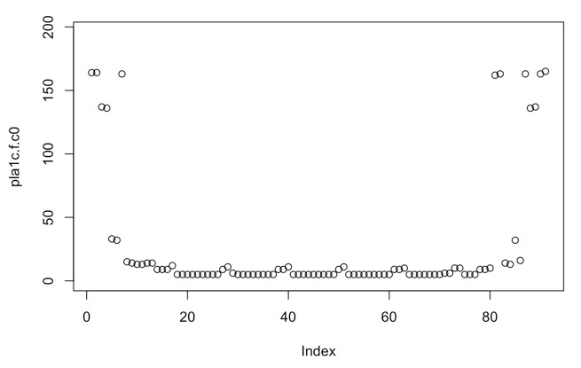
Missing Features (pla_rppos_1c)

Slide 18
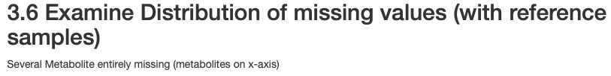
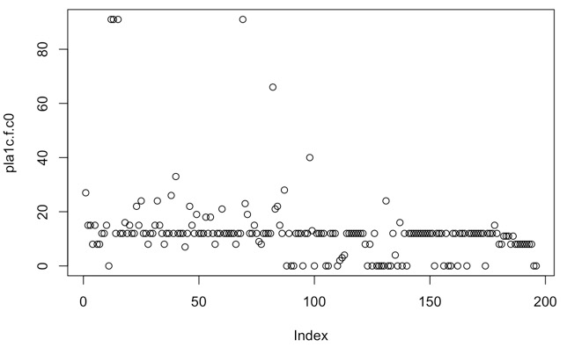

Slide 19
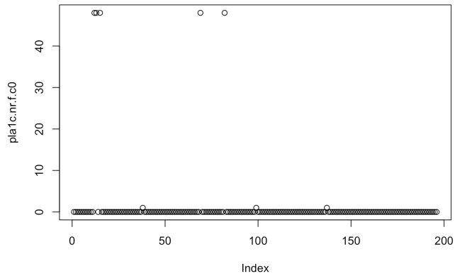

Slide 21
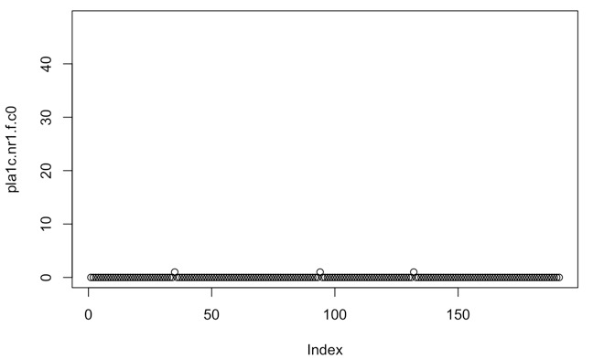
Imputation

Slide 22
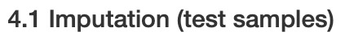
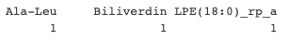

Slide 23
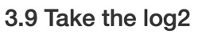
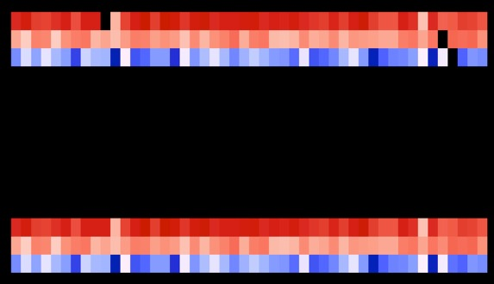

Slide 24
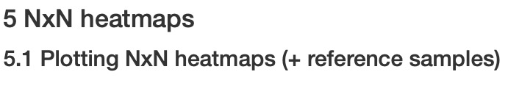
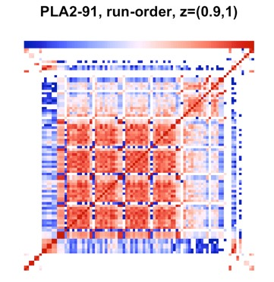

Slide 25
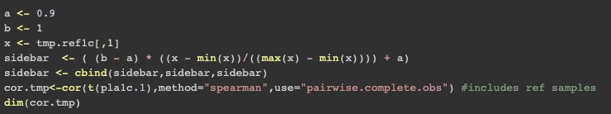

Slide 26
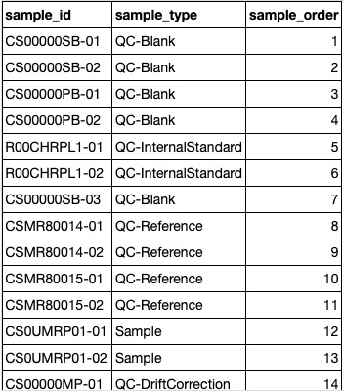
…

Slide 27
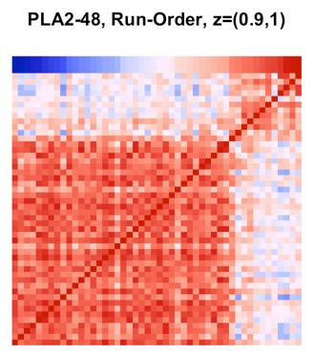

Slide 28
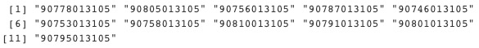
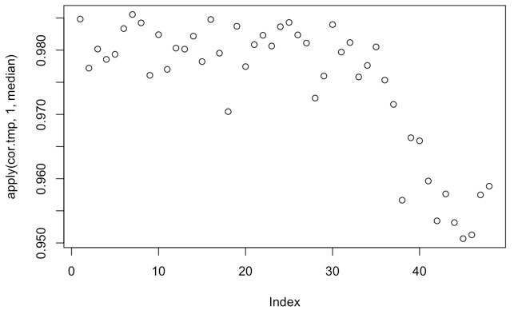

Slide 29
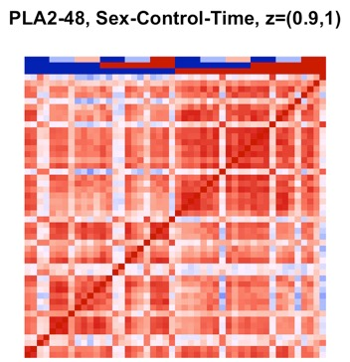
Time
Control
Sex

Slide 30
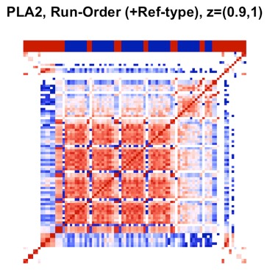

Slide 31
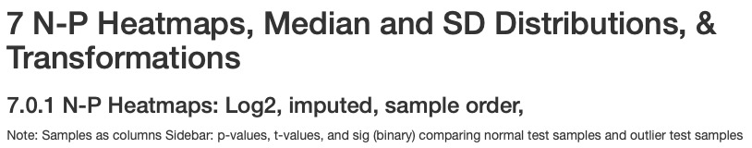
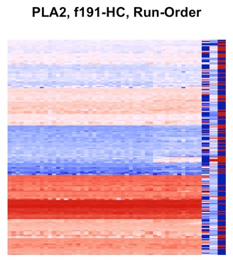
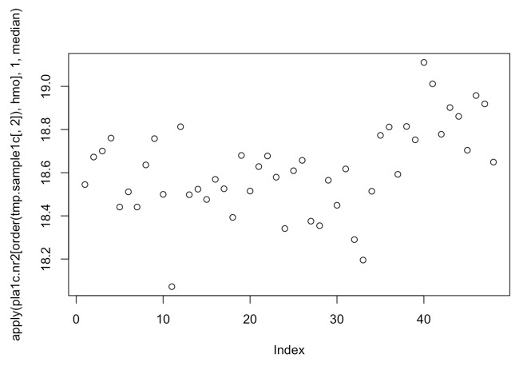

Slide 32
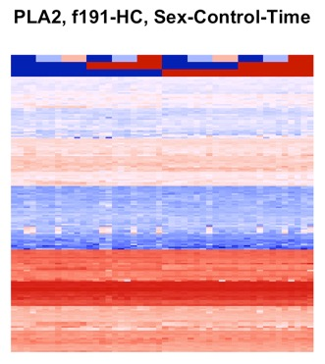

Slide 33
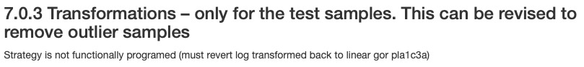
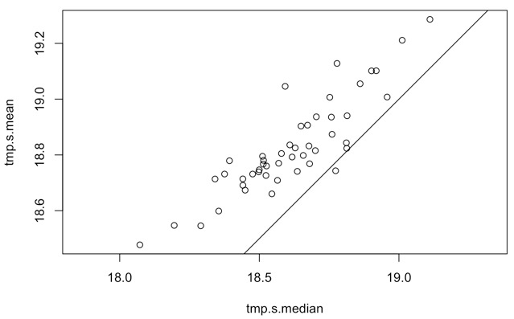

Slide 34
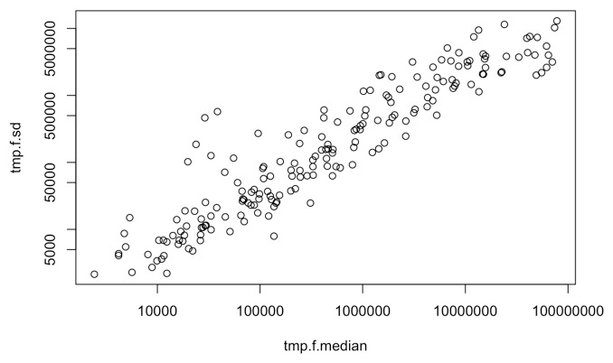

Slide 35
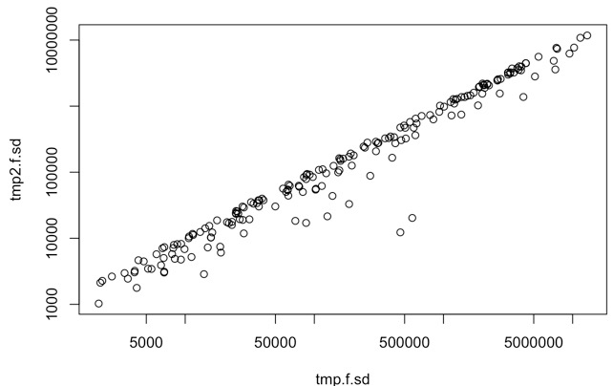
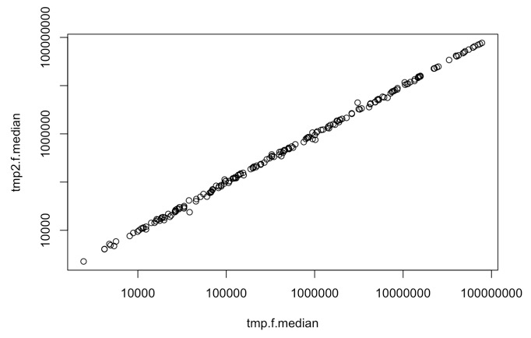

Slide 36
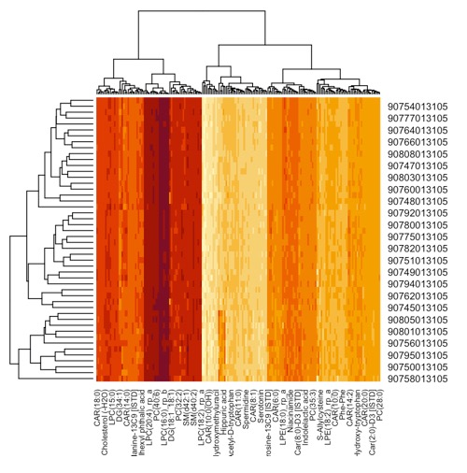
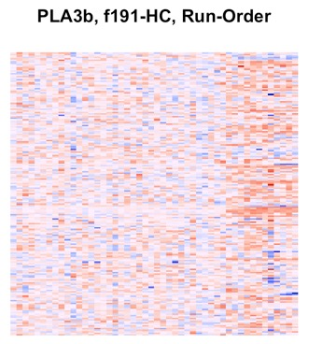
3b = Log2, imputed, median-centered (features), sd-scaled (features)

Slide 37
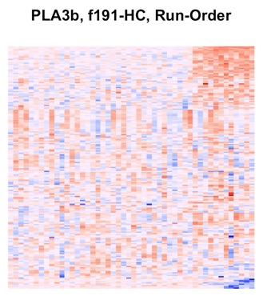
3b = Log2, imputed, median-centered (features), sd-scaled (features)

Slide 38
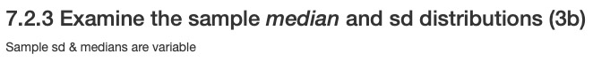
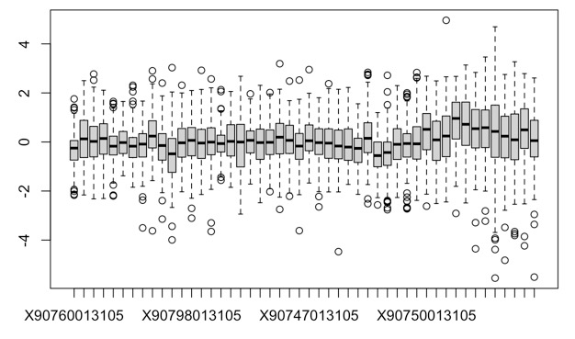
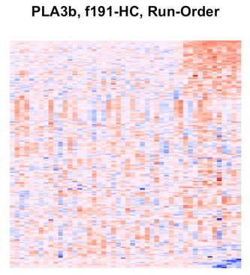
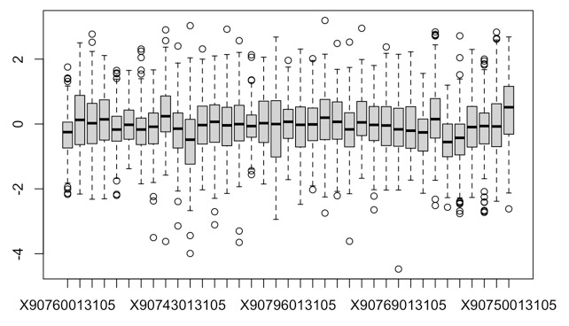

Slide 39
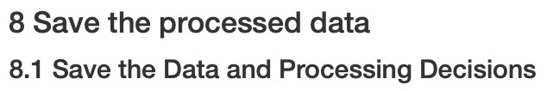
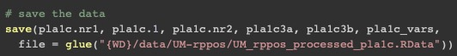

Slide 40
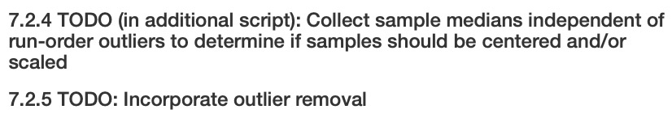

Slide 41
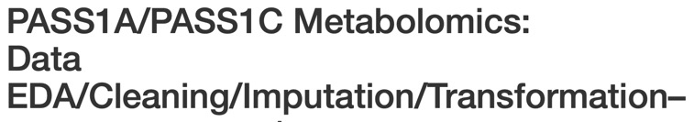
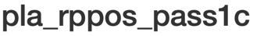
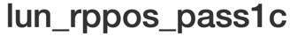
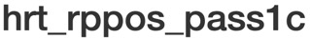
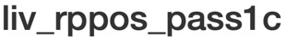
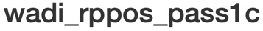
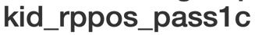


Slide 42
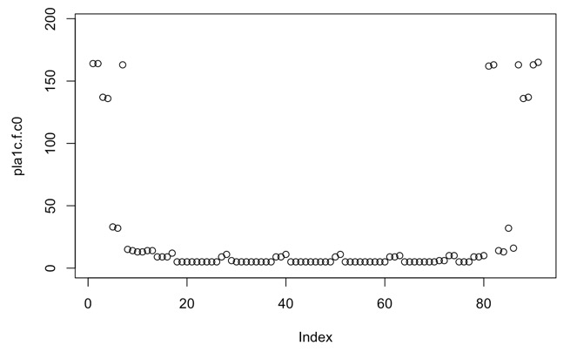
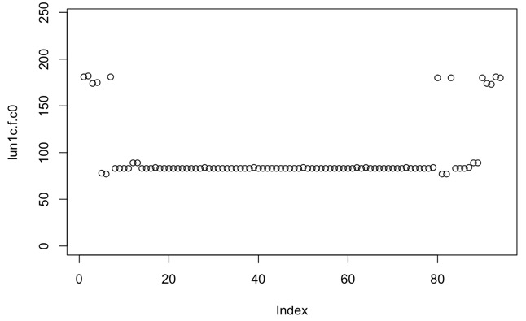






Slide 43








Slide 44









Slide 45








Slide 46








Slide 47










NA

Slide 48








Slide 49








Slide 50








Slide 51







Slide 52








Slide 53







Slide 54










Slide 55
Record of Processing Decisions

Slide 56


Slide 57
Sample/Feature Dimensions

Slide 58
Sample/Feature Dimensions
Shared
Sample/Feature Dimensions

Slide 59
Sample/Feature Dimensions
Shared
Sample/Feature Dimensions
Samples/Features (Vertically Across Tissues)

Slide 60


Slide 61




Figure generated by Jun Li, PhD

Slide 62




Slide 63




Slide 64



Slide 65




Slide 66





Slide 67


Slide 68









Slide 69








Slide 71





Slide 73




Slide 74
Contributions
Processed 1/3 of pass1a and pass1c datasets from UM
Other 2/3 should take fraction of the time
Found sources of variance/outliers
Blank samples
Run order
Sample center/spread?
All analyses documented and designed with _____ in mind
Data freezes
Competitive modeling of contributors to variance

Slide 75
Next Steps
Finish processing rpneg and ionpneg
Understand the other sources of variation
Sample center/spread
Feeding
Batch
Circadian rhythm
Build a batch correction
hierarchical multivariate model
Nothing too fancy—multivariate mixed model (assume gaussian)
Few bells and whistles: data pooling
Guidance from Jun (meta analysis?)

